Slide 1
Branding and customization
SharePoint Online Branding

Slide 3
How to View This Presentation
To switch to Notes Page view:
While in edit mode, click the View tab within the ribbon, and then click Notes Page
To navigate through notes, use the Page Up and Page Down keys
Zoom in or zoom out, if required
In the Notes Page view, you can:
Read any supporting text—now or after the delivery
Add notes to your copy of the presentation, if required
Take the presentation files home with you

Slide 4
Overview
Office 365 themes
In this Lesson
Change the look
Notes:
In this lession we will go through techniques and considerations related to brading in SharePoint Online.

Slide 5
Objectives
Review how to implement your Office 365 Theme
Using Change the look to apply company colors

Slide 6

Office 365 Themes
Suite Bar components:
Custom logo
URL for a clickable logo
Background image
Accent color
Nav bar background color
Text and icons
Modified by Office 365 Global Administrator
Applied to all Office 365 products
You can prevent users from overriding theme
Notes:
For sizing information and details: https://support.office.com/en-us/article/customize-the-office-365-theme-for-your-organization-8275da91-7a48-4591-94ab-3123a3f79530

Slide 7

Office 365 Themes
To change your theme:
Go to https://admin.microsoft.com
Navigate to Settings > Organization profile
Click Edit by Manage custom themes for your organization
Notes:
For sizing information and details: https://support.office.com/en-us/article/customize-the-office-365-theme-for-your-organization-8275da91-7a48-4591-94ab-3123a3f79530

Slide 8
Demo
Changing the Office 365 Theme
Notes:
On your SharePoint Online tenant, go to https://admin.microsoft.com and log in with a global administrator account
Under Settings in the left navigation menu, go to Settings again and then “Organization profile” a the top
Click on “Custom themes”
Explain the options you have for changing the theme
Change some of the theme options to something else and point out how it changes the top suite bar
Browse to other products using the waffle menu at the top left, such as SharePoint Online or Exchange and point out how the new theme is being shown everywhere to provide a consistent look

Slide 9
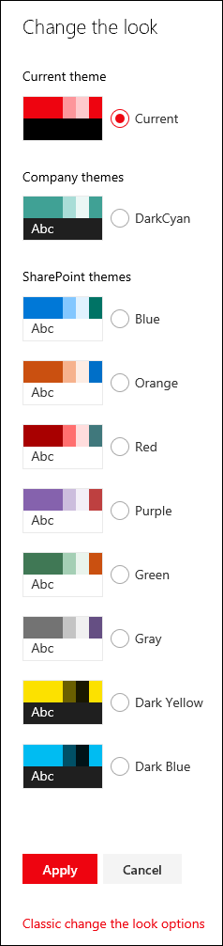
Modern Site Theming
With SharePoint Online Modern Sites, site owners have the ability to choose themes more easily
Defined using JSON schema; Theme Generator Tool can help
8 default themes; 6 light, 2 dark
Updated color palette
Control over which themes are available to users; hide default
Users select from gear icon
Can still use classic themes but less preferred on modern pages
Change the theme programatically using PowerShell, REST API or CSOM API
Notes:
For more information, see:
https://docs.microsoft.com/en-us/sharepoint/dev/declarative-customization/site-theming/sharepoint-site-theming-overview

Slide 10
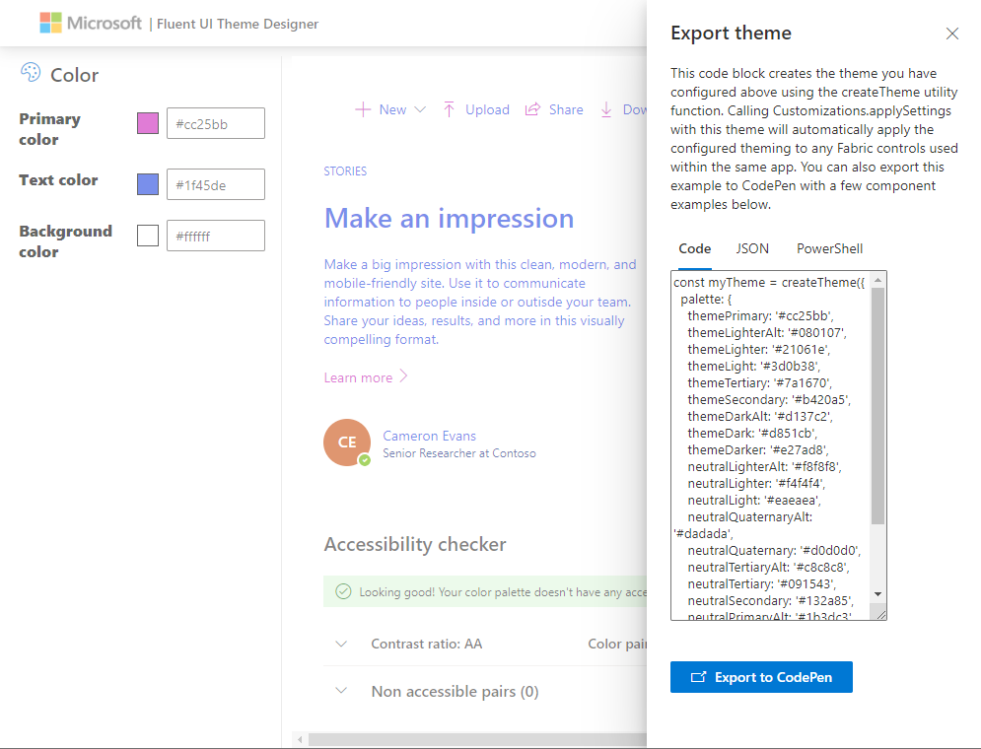
Theme Generator Tool
Notes:
You can access (and demo) the generator through here:
https://aka.ms/themedesigner

Slide 11
Add Theme Using PowerShell
$themepallette = @{
"themePrimary" = "#00ffff";
"themeLighterAlt" = "#f3fcfc";
"themeLighter" = "#daffff";
"themeLight" = "#affefe";
"themeTertiary" = "#76ffff";
"themeSecondary" = "#39ffff";
"themeDarkAlt" = "#00c4c4";
"themeDark" = "#009090";
"themeDarker" = "#005252";
"neutralLighterAlt" = "#f8f8f8";
"neutralLighter" = "#f4f4f4";
"neutralLight" = "#eaeaea";
"neutralQuaternaryAlt" = "#dadada";
"neutralQuaternary" = "#d0d0d0";
"neutralTertiaryAlt" = "#c8c8c8";
"neutralTertiary" = "#a6a6a6";
"neutralSecondaryAlt" = "#767676";
"neutralSecondary" = "#666666";
"neutralPrimary" = "#333";
"neutralPrimaryAlt" = "#3c3c3c";
"neutralDark" = "#212121";
"black" = "#000000";
"white" = "#fff";
"primaryBackground" = "#fff";
"primaryText" = "#333"
}
Add-PnPTenantTheme -Name "Custom Cyan" -Palette $themepallette -IsInverted $false
Notes:
This slide shows the PnP PowerShell needed to create a custom theme with your own custom color palette.

Slide 12
Demo
Creating a new SharePoint Online Theme
Notes:
Open PnP PowerShell and connect to the SharePoint Online admin portal of your tenant Connect-PnPOnline –Url https://tenant-admin.sharepoint.com –UseWebLogin
Execute: $themepalette = @{
"themePrimary" = "#00ffff";
"themeLighterAlt" = "#f3fcfc";
"themeLighter" = "#daffff";
"themeLight" = "#affefe";
"themeTertiary" = "#76ffff";
"themeSecondary" = "#39ffff";
"themeDarkAlt" = "#00c4c4";
"themeDark" = "#009090";
"themeDarker" = "#005252";
"neutralLighterAlt" = "#f8f8f8";
"neutralLighter" = "#f4f4f4";
"neutralLight" = "#eaeaea";
"neutralQuaternaryAlt" = "#dadada";
"neutralQuaternary" = "#d0d0d0";
"neutralTertiaryAlt" = "#c8c8c8";
"neutralTertiary" = "#a6a6a6";
"neutralSecondaryAlt" = "#767676";
"neutralSecondary" = "#666666";
"neutralPrimary" = "#333";
"neutralPrimaryAlt" = "#3c3c3c";
"neutralDark" = "#212121";
"black" = "#000000";
"white" = "#fff";
"primaryBackground" = "#fff";
"primaryText" = "#333"
}
Add-PnPTenantTheme -Identity “Developer Workshkop Theme" -Palette $themepalette -IsInverted $false
Go to a modern site on your tenant
Under the gear icon at the top right, click on “Change the look” and click on “Theme”
Choose the “Developer Workshop Theme” under “Company themes”
Point out how it changes the way our SharePoint page is shown such as some buttons and texts having become light blue

Slide 13
Knowledge Check
What do you use if you want to show your company logo above all Office 365 products
What can you configure in an Office 365 theme?
Office 365 theme
Custom logo and clickable url
Background image and color
Accent color, text and icons
Is it possible to use company specific colors in a SharePoint Change the look theme?
Yes, use the theme generator tool to set the specific colors and use PowerShell to add a new SharePoint Online theme

Slide 14
Lesson Summary
Office 365 Themes
Change the look

Slide 15
Questions?

